Slide 1
Correctness and Counterexamples
CMPT 243

Slide 2
Counterexamples
Finding a counterexample is the best way to show that an algorithm is incorrect.
Here are a few tips to keep in mind when searching for a counterexample:
Look for a small counterexample. There is usually a succinct reason why an algorithm is not correct.
Simplify the counterexample. Distill your counterexample down to its essence. This should result in a clear understanding of why it didn’t work.
Relate your counterexample to the algorithm’s strategy. Try to find a weakness in the algorithm’s underlying assumptions.
Extreme examples. Sometimes the simplest counterexamples are extreme in some way (i.e. equal numbers in a list, a tree that is a path, etc).
Consider simplifications of the problem. Sometimes the proposed algorithm fails on a simplified version of the problem.

Slide 3
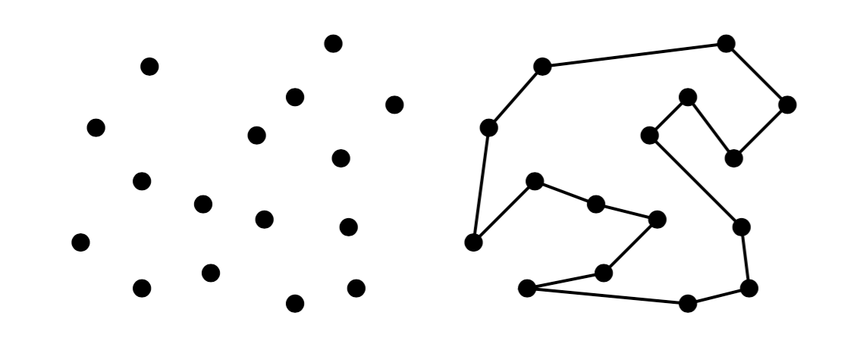
Robot Tour Optimization Problem
A robot arm must solder a collection of points, and it wishes to minimize the total distance traveled between all of the points. (Let’s also assume that the robot arm returns to its initial position after completing its soldering.)
Points on the left and one possible solution on the right.
This is a special case of the travelling salesman problem (why?).
We will consider several simple algorithms and find counterexamples for them.

Slide 4
Robot Tour Optimization Problem - Algorithm Ideas
Nearest Neighbor. Start at some point p₀ and join it to its nearest neighbor p₁, then repeat this step from p₁, and so on.
p_{o}
What would this algorithm do on the above problem?
This point set could be a counterexample for nearest neighbor, but it is not simple.
Can we find a more succinct counterexample? One that holds for all choices of p₀?

Slide 5
Counterexample for Nearest Neighbors
Consider the six points below.
v₀
v₀
1
√5
√17
2
Six points with sample distances.
What is the optimal solution? What will nearest neighbors find?
The optimal solution has length 1+1+2+2+2+2 = 10.
Nearest neighbors gives length 1+1+1+2+2+√17 = 11.123 or 1+1+1+2+4+√5 = 11.236.

Slide 6
Another Counterexample for Nearest Neighbors
Idea: Trick the algorithm into using two legs of a triangle instead of its hypotenuse.
13
12
5
Special triangle 5:12:13.
Four copies of the triangle without the middle vertex. What is the optimal solution? Nearest neighbors?
Would the same idea work with a 3:4:5 special triangle?
Notice that in the 5:12:13 triangle, twice the shortest leg is still shorter than the hypotenuse.

Slide 7
Robot Tour Optimization Problem - Algorithm Ideas
Closest Pair. Repeatedly connect the closest pair of points that will not cause a small cycle or create a vertex of degree three.
What would this algorithm do on the above problem?
This point set could be a counterexample for closest pair, but it is not simple.
Can we find a more succinct counterexample?

Slide 8
Counterexample for Closest Pair
Consider our first counterexample from Nearest Neighbors.
1
√5
√17
2
Six points with sample distances.
What will Closest Pair find?
The optimal solution has length 1+1+2+2+2+2 = 10.
Closest Pair gives length 1+1+1+2+2+√17 = 11.123.

Slide 9
Robot Tour Optimization Problem - Algorithm Ideas
Brute Force. Try all possible orders of points and choose the best one. In other words, consider all permutations of the n points.
How many different orders of points are there?
Brute Force will always work, but it is very slow.

Slide 10
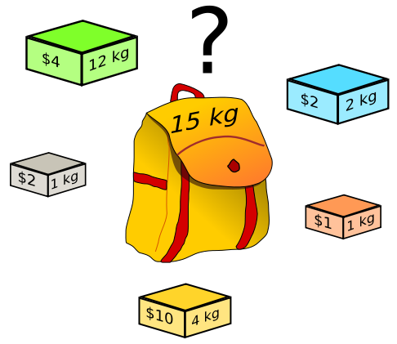
Thief Problem
A thief has broken into a house and wishes to steal items that are worth as much money as possible. The constraint is their backpack can only carry 15 kilograms.
An instance of the knapsack problem.
This problem is known as the knapsack problem. The knapsack holds weight W and there are n items s₁, s₂, …, s_{n} where the i^{th} has weight w_{i} and value v_{i}.
Note: The textbook considers a simpler version of this problem in Chapter 1.

Slide 11
Thief Problem - Algorithm Ideas
Best-First. Add items with highest value/weight ratio so long as they fit.
item | value | weight | ratio
1 | $4 | 12 kg | $0.33 / kg
2 | $2 | 2 kg | $1 / kg
3 | $2 | 1 kg | $2 / kg
4 | $1 | 1 kg | $1 / kg
5 | $10 | 4 kg | $2.50 / kg
What does the algorithm do in this case?
The algorithm would choose items 5, 3, 2, 4 and then it could not fit item 1.
Does this algorithm always work?

Slide 12
Counterexample for Best-First
Consider a knapsack with a capacity of 3 kg and the following two items.
item | value | weight | ratio
1 | $2 | 1 kg | $2 / kg
2 | $3 | 3 kg | $1 / kg
What does the algorithm do in this case?
The optimal solution is $3 by choosing item 2.
Best-First obtains $2 by choosing item 1.

Slide 13
Thief Problem - Algorithm Ideas
Brute Force. Try all possible subsets and choose the most valuable that fits.
How many subsets do we need to try?
Brute Force will always work, but it is very slow.

Slide 14
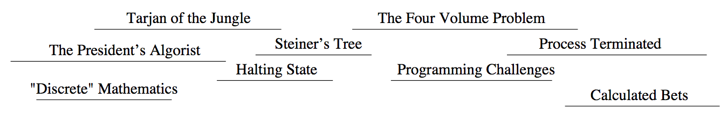
Movie Star Scheduling Problem
A movie star has been offered the leading role in several upcoming movies. They want to select the maximum number of roles such that no movies overlap in time.
A selection of movies along with their start and end times given as an interval of time.
This problem is known as maximum independent set in an interval graph.
We will consider several algorithms and find counterexamples for (most of) them.

Slide 15
Movie Star Scheduling - Algorithm Ideas
Starting-First. Accept the job that starts soonest and doesn’t conflict.
Shortest-First. Accept the shortest job that doesn’t conflict.
Ending-First. Accept the job that ends soonest and doesn’t conflict.
Brute Force. Try all possible subsets of jobs and choose the best.
What would these algorithms do on the above problem?
Brute Force will work, but slowly. For the other ideas try to find a counterexample.
If you cannot find a counterexample, then try to understand why it works.

Slide 16
Counterexamples for Starting-First and Shortest-First
The first two ideas have counterexamples that use only three intervals.
Counterexample for Starting-First
Counterexample for Shortest-First
Notice that these examples are not counterexamples for Ending-First.

Slide 17
Correctness of Ending-First
Theorem: Ending-First correctly solves the Movie Star Problem.
Proof: Suppose Ending-First chooses roles r₁, r₂, …, r_{x} in order for a given Movie Star Problem.
For the sake of contradiction, consider a valid list of roles ordered by earliest ending time t₁, t₂, …, t_{y} with y > x.
Let’s first prove that r_{i} ends no later than t_{i} for all i ≤ x by induction on i.
Base Case: This is true for i = 1 by the Ending-First algorithm.
Inductive Assumption: Assume the claim is true for i = k for some k ≥ 1.
Inductive Conclusion: Now consider i = k+1. By induction, r_{k} ends no later than t_{k}. Therefore, the Ending-First algorithm could choose t_{k}+1 without creating a conflict. Therefore, its chosen role r_{k}+1 ends no later than t_{k}+1.
This argument implies that r_{x} ends no later than t_{x}. We also know that there exists a movie t_{x+1} since y > x. Therefore, r₁, r₂, …, r_{x}, t_{x+1} has no conflicts. Therefore, the Ending-First algorithm would have selected t_{x+1} next. This contradicts our choice of r₁, r₂, …, r_{x}, and so our assumption is not true.
Brute Force is also correct, but it would be much slower than Ending-First.
Finding algorithms that are faster than Brute Force is central to algorithm design.

